Slide 1
PL-600 Robotic Process Automation

Slide 2
Agenda
Review the need for Robotic Process Automation
Explore Power Automate Desktop
Considerations for creating and running desktop flows
Introduction to Process advisor
Notes:
Robotic Process Automation is concerned with the automation of legacy applications. Understanding the capabilities of Power Automate Desktop is required when integrating a Microsoft Power Platform solution. This module is concerned with Power Automate Desktop and its capabilities.
In this module, you will:
- Explore options for automation and how to choose where to start.
- Explore scenarios for Power Automate Desktop.
- Understand the components for running Power Automate desktop flows.

Slide 3

Introduction to Robotic Process Automation
Notes:
Introduction to Power Automate Desktop and the use cases for desktop flows
This unit introduces Robotic Process Automation (RPA) and the use cases for Power Automate desktop flows.

Slide 4
Characteristics of RPA
Capture steps performed by a user
Repeat the steps
Desktop application user interface
Perform on the application user interface
Web applications in browsers
Simple to complex tasks and processes
Operating system actions
Reduce costs
Clicks and keyboard entry
Reduces errors
Notes:
There are many legacy applications that do not have a method for accessing their data or functionality except through their user interface. RPA solutions operate by generating a list of actions by capturing the steps a user performs in an application's user interface. The RPA solution then performs the automation by repeating the steps in the application's UI, effectively simulating the user's actions in software. RPA enables the automation of applications that do not have an API that can be used for such automation tasks.
Robotic Process Automation (RPA) is garnering a lot of interest and attention. By automating simple tasks, RPA solutions promise to lower costs while reducing errors.

Slide 5
Opportunities for automation
The best organizations are powered by strategic and creative people, but they are often forced to spend nearly half their time on repetitive tasks that could be automated with current technology
Who
60% of all occupations have at least 30% automatable activities
Scope
Almost 50% of work activities globally can be automated using current technology
Improvement
Data collection and processing times can improve by 64% with automation
Notes:
When analyzing work performed by users the following has been observed:
- 60% of all occupations have at least 30% automatable activities.
- Almost 50% of work activities globally can be automated using current technology.
- Data collection and processing times can improve by 64% with automation.
The best organizations are powered by strategic and creative people, but they are often forced to spend nearly half their time on repetitive tasks that could be automated with current technology.

Slide 6
Automating legacy systems
Issues that prevent automation
Lack of a modern API
Systems are complex and costly to replace
Connecting to on-premises systems
Notes:
A major roadblock in automating systems and workflows can be that legacy and other third-party applications have no modern API data access that allow tools such as Power Automate to include them in their cloud flows.
It is not always possible to replace the legacy applications either because of difficulty or the costs to replace them. In addition, many legacy applications are on-premises and it can be hard to link to the on-premise applications and combine them with cloud services in an end-to-end automation process.
A number of RPA solutions have been developed to solve this problem. Power Automate desktop flows are Microsoft's answer to this problem.

Slide 7
Microsoft's approach to automation
Accelerate productivity
Minimize repetitive, manual, time-consuming tasks and create more time for your teams to focus on strategic work.
Automate at scale
Allow everybody in your organization to automate workflows using connectors for their favorite on-premises and cloud-based apps and services. From end users, professional developers, to IT.
Apply intelligent automation
Streamline how you work by combining the power of AI with automated workflows and business process.
Integrate automation, more securely
Enable end users to build automated workflows that comply with established policies and focus your skilled IT resources on more complex, strategic work.
Notes:
There are many SaaS services that can be accessed with modern REST APIs that automation tools such as Power Automate can connect to and orchestrate for the purposes of integration and automation of tasks.
Microsoft's approach to automation is:
- Accelerate productivity: Minimize repetitive, manual, time-consuming tasks and create more time for your teams to focus on strategic work.
- Automate at scale: Allow everybody in your organization to automate workflows using connectors for their favorite on-premises and cloud-based apps and services. From end users, professional developers, to IT.
- Apply intelligent automation: Streamline how you work by combining the power of AI with automated workflows and business process.
- Integrate automation, more securely: Enable end users to build automated workflows that comply with established policies and focus your skilled IT resources on more complex, strategic work.

Slide 8
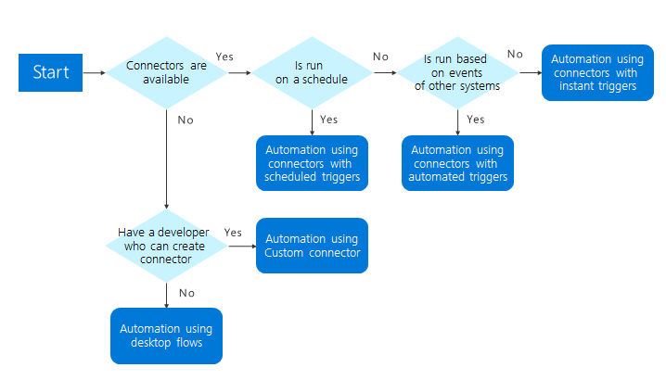
Power Automate
Options
Pre-built Connectors
Custom connectors
Desktop flows
Notes:
Using Power Automate, a solution architect can create innovative solutions. However, what happens when there isn't a connector available. If the service has a modern REST API then you can create a custom connector. If there isn't an API then Power Automate desktop flows are available.
This flowchart can help you determine how to architect your automation.

Slide 9

What are the solution architect’s role?
Classroom discussion
Notes:
Ask What should the solution architect consider for using RPA to solve - be creative!

Slide 10
Role of the solution architect
The solution architect should look for good opportunities for automation.
Standard process
High frequency
Predictable processes
Prone to human error
High risk of failures and impact
Notes:
By using Power Automate cloud and desktop flows, a solution architect can design end-to-end processes that encompass modern cloud services, legacy desktop, and web applications.
The solution architect should look for opportunities for automation. Good opportunities exhibit the following characteristics:
- Standard process: Is the process well understood and consistent in how it needs to be executed?
- High frequency: Is this a process that runs frequently and the ROI exists to spend build cycles on it?
- Predictable processes: Are the outcomes predictable or do they require any judgement calls by humans?
- Prone to human error: Is there a risk that a human may introduce errors as a result of manually completing this process? Are there a lot of steps that are easy to perform out of order?
- High risk of failures and impact: Is the risk and/or impact of a failure high that could be mitigated through automation?
There are many uses for desktop flows. You can consider any scenario where there is the processing of forms, extracting data from systems, or processing claims where the data needs to be verified for automation with desktop flows. If you have rule-based processing, desktop flows are a viable candidate for automating those processes.
The introduction of Power Automate Desktop opens up many scenarios that would not have been possible or would have been extremely difficult and expensive to achieve.
Desktop flows can be also be used for situation where there is an API but the API does not expose all of the operations available in the application's UI. In such circumstances, Power Automate Desktop maybe the answer.
During design, the solution architect should separate flows into smaller automations so that you don't have a single automation that covers the entire process. There are several reasons why you should make multiple, smaller flows:
- Multiple people can work on the automation.
- Small flows with common steps may be able to be reused.
- Error handling does not need to be as sophisticated.
- Maintenance is easier.
- Easier to manage the automation if a step fails.

Slide 11

Explore Power Automate Desktop
Notes:
Overview of Power Automate Desktop software and capabilities

Slide 12
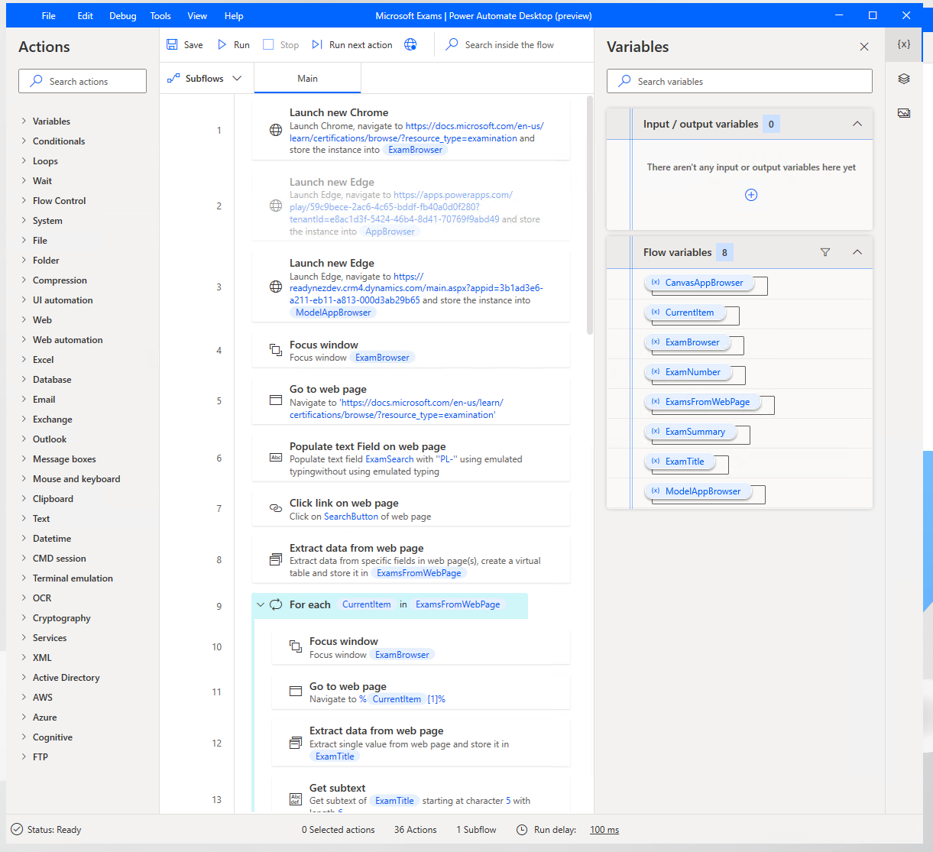
Power Automate Desktop
Tools for building and running desktop flows
Build
Capture and edit user actions for desktop and mobile applications
Running
Runs desktop flows
Notes:
Power Automate desktop flows are for automation where there is no connector or API available to use. There are many legacy applications that do not have a method for accessing their data or functionality except through their user interface.
Power Automate Desktop flows use Robotic Process Automation (RPA) techniques to automate user actions on these legacy applications. These techniques require software to be installed on the computers where the applications are installed. The software required to create, edit, and run desktop flows is called Power Automate Desktop.
Whether working with modern or legacy apps, on-premises or in the cloud, Power Automate Desktop can automate rule-based UI tasks by recording mouse clicks, keyboard inputs, and data entry. As well as entering data, Power Automate Desktop can also extract information from the application user interface. Once the actions have been recorded, Power Automate Desktop has a rich editor for adjusting these user actions to create complex desktop flows.
Power Automate desktop flows can be run attended with the user manually initiating the flow, or unattended with desktop flows running on Virtual Machines in Azure.
Power Automate desktop flows are a valid way to perform integrations and automation when there is no other alternative, or when developing an integration would be expensive and time consuming.
Power Automate cloud flows are explained in the Power Automate Architecture module.

Slide 13
Software
Power Automate Desktop
To editing and running desktop flows
Browser Extensions
For web applications
On-premises data gateway
For connecting cloud to desktop
Windows application
Extensions for modern web browsers
Used for Power BI, Power Apps, Power Automate, Logic Apps
Windows 10, Server 2016, Server 2019
Google Chrome, Microsoft Edge, Mozilla Firefox supported
Installed on same computer as PAD
Windows 10 Pro/Enterprise required for unattended mode
Additional browser settings
Required for unattended mode
Notes:
Desktop software
Unlike the rest of the Microsoft Power Platform tools, Desktop flows require software to be installed on your local computer. You need this software because you need to interact with software applications that are not accessible from the cloud.
The Power Automate Desktop app is a Windows application that you use to create, edit, and run desktop flows.
You will need a computer running Windows 10, Windows Server 2016, or Windows Server 2019 to install Power Automate Desktop.
For unattended flows Windows 10 Home is insufficient and Windows 10 Pro or Windows 10 Enterprise is required.
To initiate a desktop flow from the cloud, a second application is required to be installed on the computer where Power Automate Desktop is installed. This is the On-premises data gateway. This tool allows desktop flows to be triggered by a Power Automate cloud flow.
As a solution architect, you will need to liaise with the IT department to arrange for these software applications to be installed. Local software installation can often take much longer to plan and implement than you may think due to IT policies and procedures. If you are planning to use RPA in your solution, you should look to address the deployment of this software as early as possible.
Browser software
To interact with web applications, a modern web browser is required. The latest version of the Google Chrome browser, Microsoft Edge, and Mozilla Firefox are supported.
A browser extension is required to be installed. These can be installed by the Power Automate Desktop installer but may require additional configuration. Again, the solution architect will need to liaise with the IT department as installing browser extensions maybe blocked by corporate IT policies.
There are some further settings for browsers that should be configured. These are described in <https://docs.microsoft.com/power-automate/desktop-flows/using-browsers> and the solution architect will need to arrange for these settings to be applied.

Slide 14
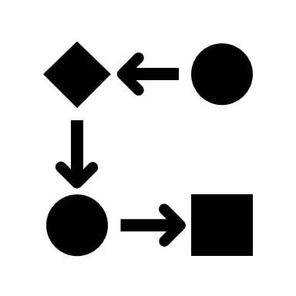
Creating desktop flows
Notes:
Key concepts for capturing and editing the steps in desktop flows

Slide 15

Capture steps
Two options
Desktop recorder
Records the steps on Windows native applications
Web recorder
Records steps in a browser for web applications in browsers
Notes:
Power Automate Desktop can both capture the steps performed by the user and edit the steps in desktop flows.
The user can record tasks with
- Desktop recorder: Records the steps on Windows native applications.
- Web recorder: Records steps in a browser for web applications.
The Desktop recorder identifies and highlights objects in the application user interface such as buttons, menus, and fields. It then records the mouse clicks and keyboard entries against that object.
The web records identifies what is clicked and entered into a web page. The process is similar and is tailored towards web applications.

Slide 16
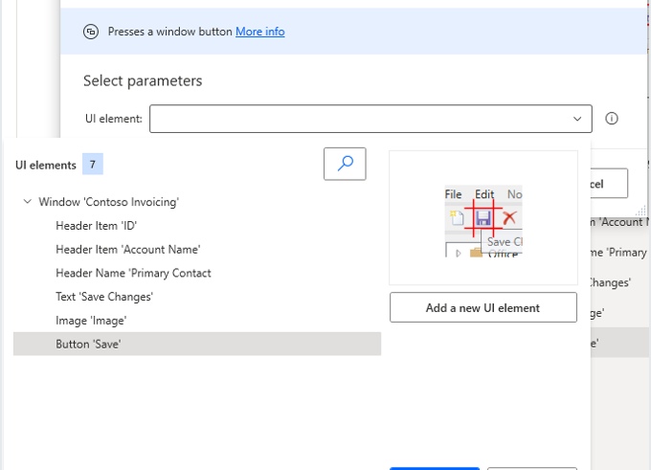
Editing steps
Extract information
Remove actions
Add new actions
Edit the selected objects
Add conditionals and loops
Notes:
Once steps have been recorded, you can edit to remove unnecessary actions and add further actions. You can also edit the objects selected in the application and add new UI objects.

Slide 17
Variables
Define values that change for each run of a desktop flow
Flow variables
Input and Output variables
Notes:
Flow variables allow information to change in every run of a desktop flow. If you are using a desktop flow for any type of data entry, you will need flow variables to define the fields that you need to enter. The solution architect should encourage the use of flow variables and ensure that there is a naming convention for variables.
Input variables are information that you pass to a desktop flow. Output variables are outcomes that the desktop flow passed back after the desktop flow has run. Power Automate Desktop provides the ability to receive input values from cloud flows and return values back to the cloud flow by using output variables. As a result, your automations can be seamlessly integrated. The solution architect should ensure that the input and output variables are specified at the design stage as it is likely that cloud and desktop flows will be built by different makers.
If input variables are different for each environment, then you should define Environment Variables for input variables in the flows.

Slide 18

Running desktop flows
Notes:
This unit is about Running Desktop flows in attended and unattended modes

Slide 19
Summary
Power Automate desktop flows enable integrations and automations that were no possible before
The solution architect should consider using Power Automate Desktop as part of the solution
The solution architect can design end-to-end automation across web, legacy, and on-premises systems
Notes:
The solution architect should understand how to use RPA to create end-to-end automation across web, legacy, and on-premise systems. Power Automate Desktop enable more options for automating and integrating solutions and its use should be carefully evaluated by the solution architect.

Slide 20
Closing slide

